Slide 1


HOUSING PRICE PREDICTION USING ML
SUBMITTED BY:-
LAKSHAY BANSAL
UNIVERSITY ROLL NO: - 2018903
SEC – CSE-B
UNDER MENTORSHIP: -
DR. VIKAS TRIPATHI
ASSOCIATE PROFESSOR

Slide 2
INTRODUCTION and PROBLEM STATEMENT
Problem statement: - To predict a price for a home using the technology of machine learning.
Factors depending on Buying a house:-
Total Area
Locality or location
No. of Rooms
No. of Bathrooms
5. No. of Floors and Storeys and
In this project, I am predicting the price of the house using ML by taking some of the factors.
many others depending upon the individual.

Slide 3
METHODOLOGY
SUPERVISED METHOD OF MACHINE LEARNING:- In this type of learning is based on the labeled datasets with the previous results to predict future outcomes.
Data Loading: - I load my data of the CSV file into the python program with the help of the pandas read_csv() function to work on that dataset with the help of python libraries.
Data Cleaning: - From that big dataset I have removed the null value data to work on a good dataset only with the help of dropna() function.
Feature Engineering: - Feature engineering means adding some new features to your dataset to find some patterns and then working on that data accordingly here I added price_per_sqft and the area is in range for the BHKs so also make it to the fixed mean value.

Slide 4
Outliner Removal: - It is a process in which the data having average cases are kept and the rare cases are removed from the datasets.
a) Using Business Logic: - In this, I take a piece of knowledge from the internet that there are some criteria that the room should have a minimum area of approx. 285 sq. ft., so less than that area rooms are removed from data sets.
b) Using Standard Deviation and Mean: - In this, I find the mean and std. deviation of price_per_sqft and then locations having properties having the cost of less BHK is higher than the more No. of BHK case, so removed that kind of dataset.
c) Using Bathroom Feature: - According to the trend total no of bathrooms is less than and equal to BHK+2. So removed those outliners having more than bathrooms.
Dimensionality Reduction: - In this, I study the location stats, and then according to that I reduce the data sets by removing the data having less than 10 properties in a location.

Slide 5
Model Building: - In this now I check for the accuracy and regression for my dataset and after that final prediction function and testing of that function is done.
a) Linear Regression: - It is used to estimate real values (cost of houses, number of calls, total sales, etc.) based on a continuous variable(s). Here, we establish the relationship between independent and dependent variables by fitting the best line. This best-fit line is known as the regression line and is represented by a linear equation.
Y= a *X + b.
b) K fold cross Validation: - It is a technique to check the accuracy for the different test sizes and selecting different sample cases for the accuracy of the dataset, Here I used K fold cross-validation for linear regression, and I get a result for them then I future continue to create a prediction function and segment for the desire data.
c) Prediction function: -Here I make the final segment of my code where we can predict the price for various locations, sizes, BHK, and no of the bathroom as an argument and get the approximate price for that house or home.

Slide 6
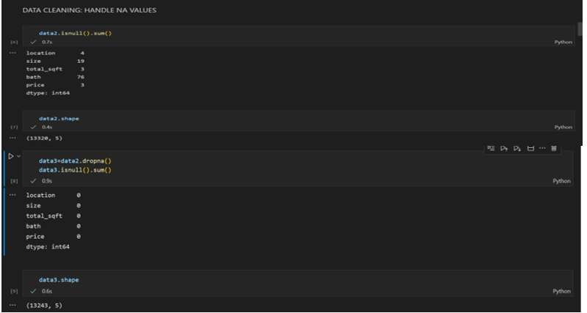
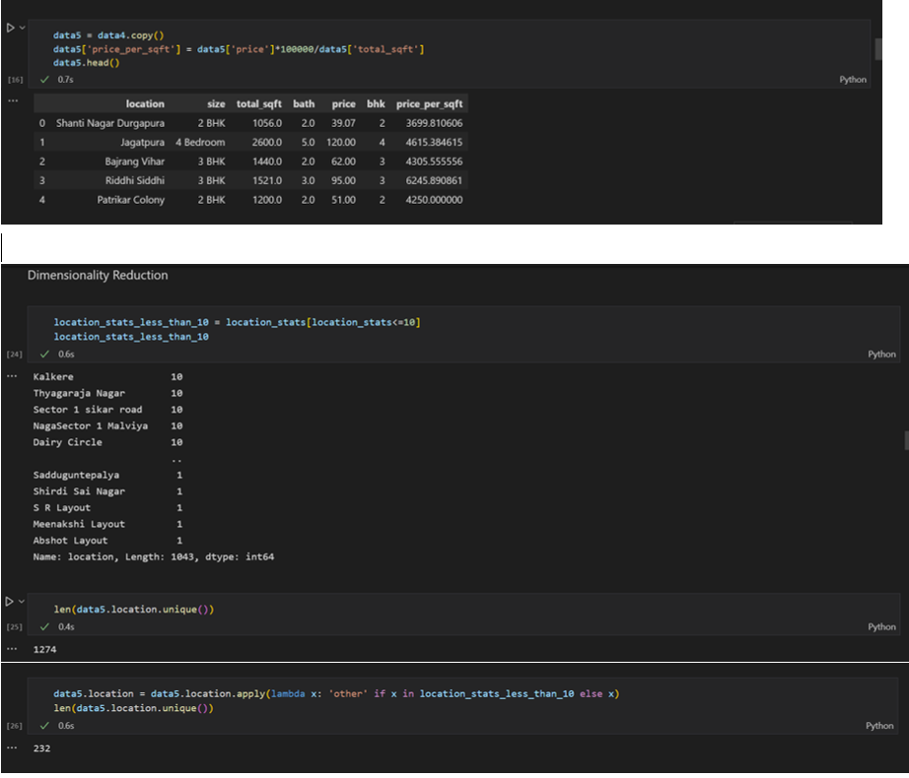
RESULT AND DISCUSSION
DATA CLEANING:-
FEATURE ENGINEERING AND DIMENSIONALITY REDUCTION: -
Discussion: -
In fig cleaning the dataset is shown by the NA values as all the null values are shown and then all the null values are dropped using the dropna() function and the dataset size becomes 13243 from 13320.
Discussion: -
Fig (a) uses feature engineering a new column of price_per_sqft. is created in the dataset and the value of every data is present in the front of each data cell of the dataset.
In fig (b) Dimensionality Reduction is done by removing the data according to the dimensions of 10 if less than 10 then removing and reducing the dataset to make it a more accurate prediction.

Slide 7
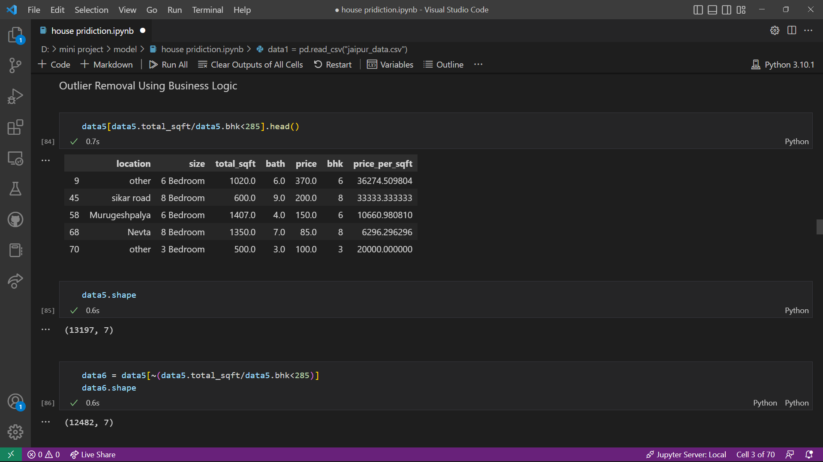
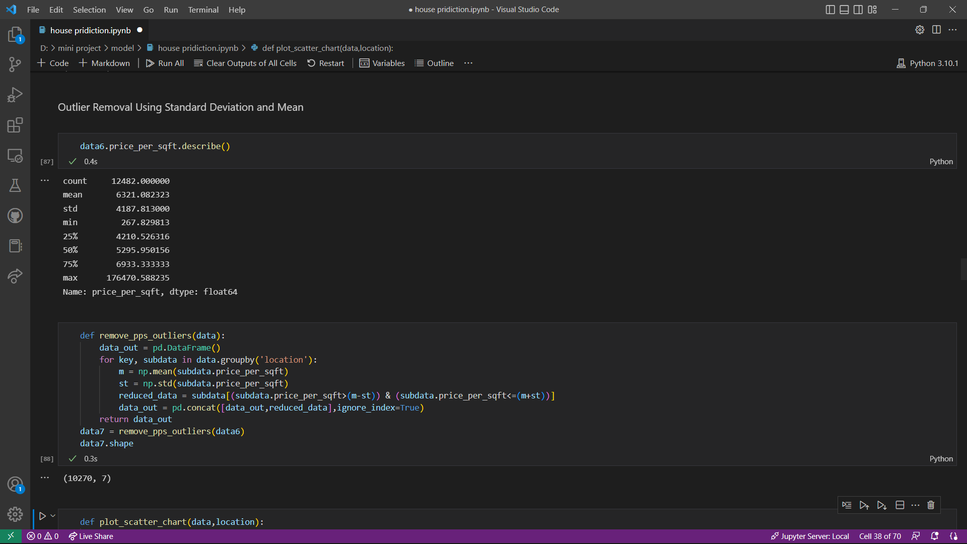
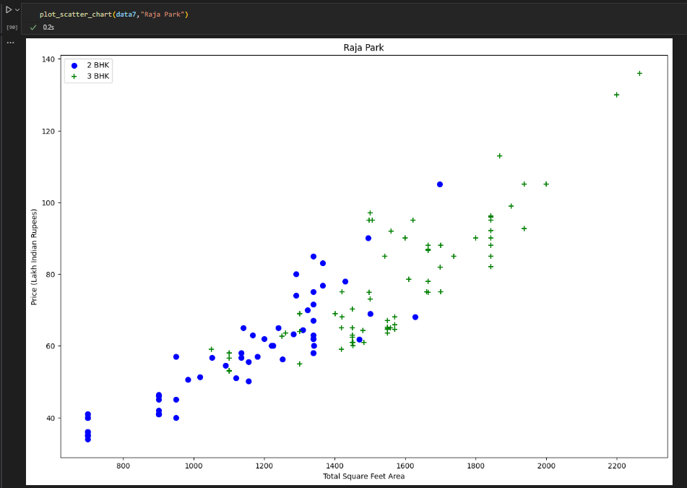
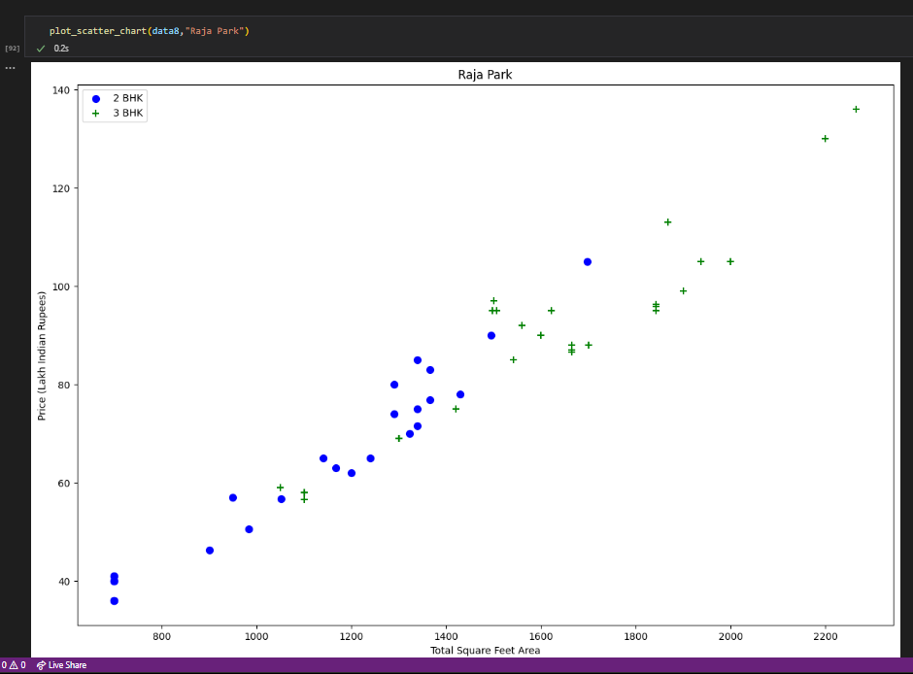
OUTLINER REMOVAL
USING BUSINESS LOGIC: -
USING STD DEVIATION AND MEAN: -
Discussion: -
In all figures, the outliner removal is shown, and in fig (c) first, the scatter chart is when the removal of the less BHK home has more price than the more BHK home and after using the outliner removal code for that the second chart is formed where the data filtered and become more accurate.

Slide 8
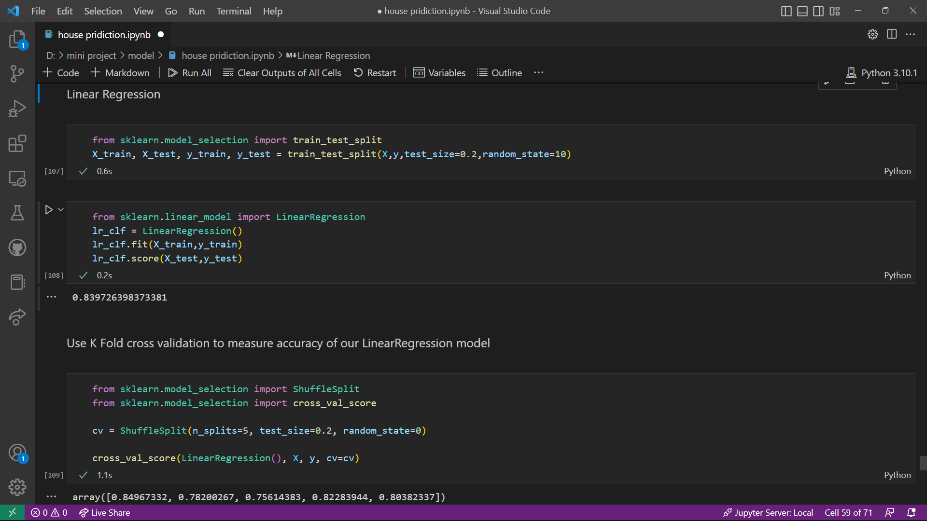
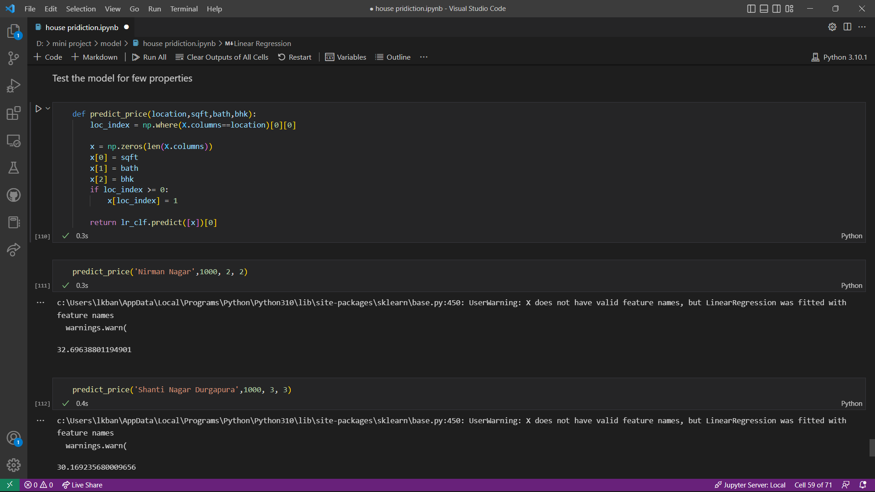
MODEL BUILDING
LINEAR REGRESSION AND K-FOLD CV
PREDICTION FUNCTION AND TEST
Discussion: -
In fig (a) linear regression and cross-validation of linear regression have been done and the score is not less than 75% so it is good accuracy to predict a price for the user choice of data.
In fig (b) price prediction function has been written where all dependent data members as an argument i.e., location, area in sq ft., BHK, and the number of bathrooms after giving them it will predict the price for the house, and my project is successfully done.

Slide 9
CONCLUSION:- Through this mini project I learned the basics of data science using the different algorithms of machine learning and data science, we know that it is a very vast field of a Computer Science stream and here I can learn a small part of it and how to create a raw data and then after creating a raw dataset, then using different algorithms and functions make that dataset an efficient dataset and then work on that efficient dataset like prediction and accuracy check and many other.
And In housing price prediction many factors can vary the price but, in my
project, I mentioned some of them and make an efficient prediction about
them.
FUTURE WORK: - As, now in the world of digitalization all the platforms are going online and converting into digital, so by this project in future, the traditional way of brokerage between the buyer and the seller can be covered and this kind of application can make purchasing and selling of the property more convenient and simple, as both of them can predict a price of their dream home by different criteria here you can make this vaster by adding features like amenities near the property, kind of locality, reachability and transportation facilities and every smaller thing can be added and make more accurate and précised value for the home.

